Slide 1
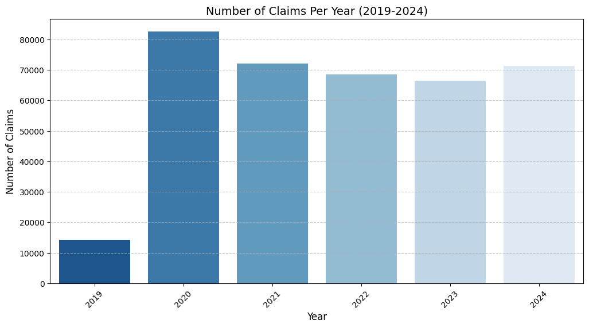
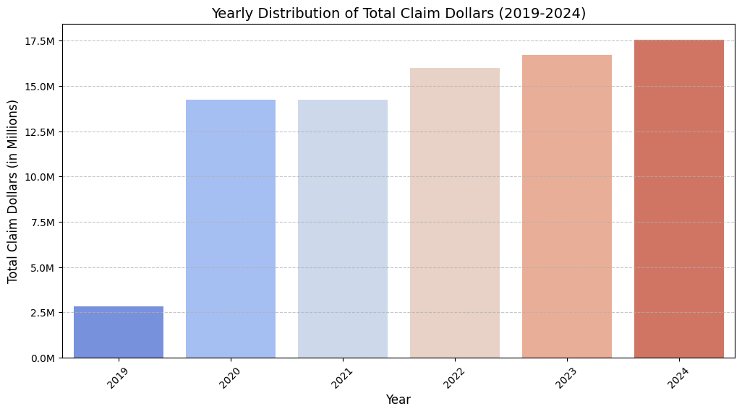
Insights from the Data
Data Sources & Structure:
Claims Data: Contains claim numbers, product details, repair dates, and total claim dollars.
Failure Part Data: Includes failure part, failure descriptions, complaint diagnosis, work performed, and vendor details.
Replacement Part Data: Details parts replaced, labor costs, and part pricing.
Data Quality Observations:
Some missing values in Transmission Model, Engine Serial, and Failure Part (handled appropriately)
Outliers observed in Total Claim Dollars (some negative and extremely high values).
Some invalid dates (e.g., ‘9998-12-31’) in purchase and failure date columns, cleaned by replacing them with NaT.
Insights From Claims Data and Total Claim Dollars:
Total Number of Claims = 375364
Claims Decreased slightly From 2020 to 2023, but they got increased in 2024
Though, number of claims slightly reduced each year from 2021 to 2023, The total claim dollars has increased steadily which indicates that the warranty repair is getting costlier each year for SBD.
Additional Key insights
Top 10% of Claims Contribution: 47.11% of total claim dollars
Bottom 50% of Claims Contribution': 15.26% of total claim dollars

Slide 2
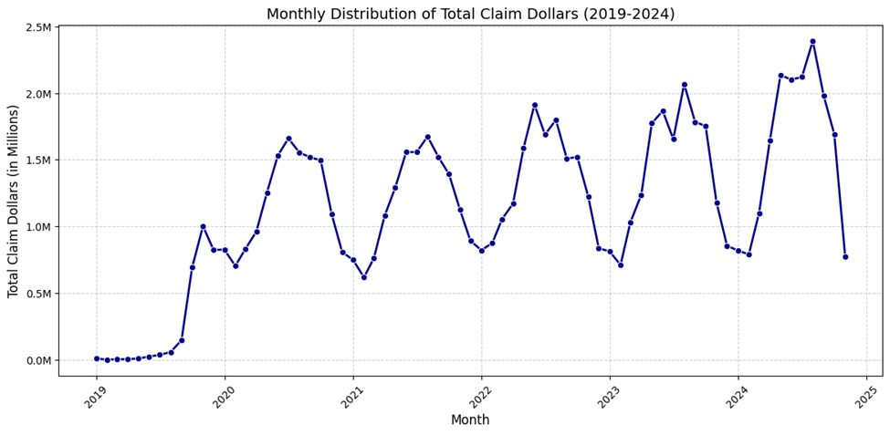
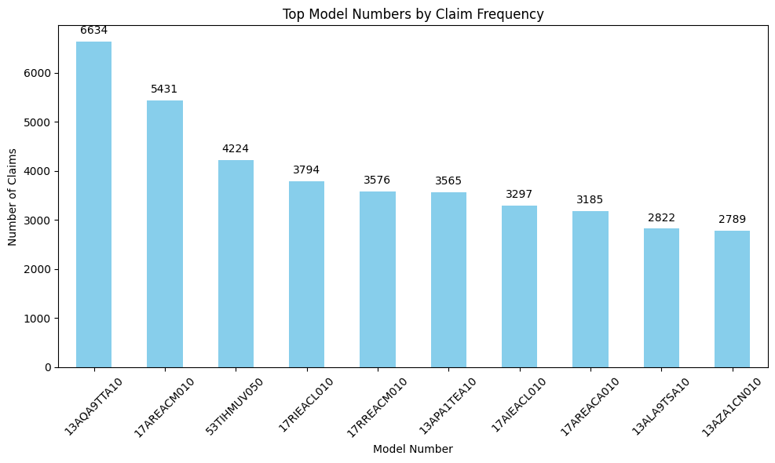
Exploratory DATA ANALYSIS
Seasonal Trends in Claims:
We noticed a seasonal pattern in the Total Claim dollars Value – Summer Months shows higher failure rates(July being the top).
Top Finished Good models:
The 17 series models appear 5 times in the top 10, indicating a recurring issue across multiple models in this series.
The 13 series models account for 4 out of the top 10, showing that both series contribute significantly to total claims.
Highest Claim Model:
The 13AQ97TA10 model has the highest number of claims (~6,600 claims), followed closely by 17AREACM010 (~5,400 claims).
This suggests potential design, material, or component issues specific to these models.

Slide 3
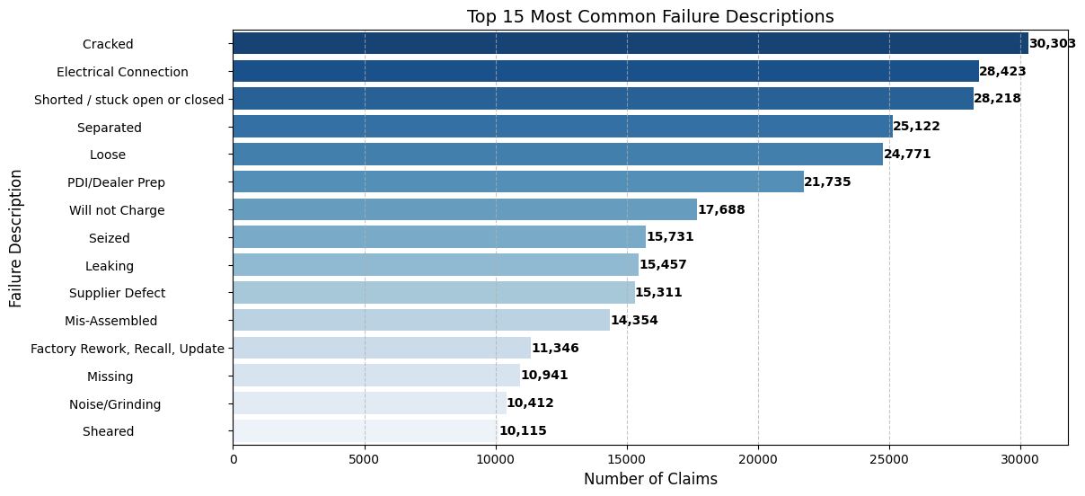
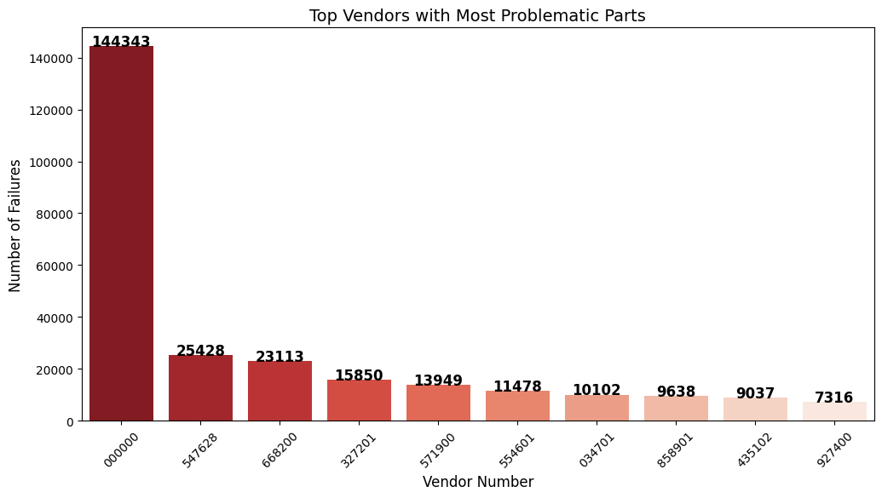
Top Common Issues For Failure:
“Cracked" is the most common failure, appearing in 30,303 claims, followed by "Electrical Connection" (28,423 claims) and "Shorted/Stuck Open or Closed" (28,218 claims).
"Cracked," "Separated," "Loose," "Sheared" are among the top failures, indicating potential design flaws or poor material quality.
"Mis-Assembled" and "Supplier Defect" suggest potential issues with assembly line processes or supplier quality control.
Top Vendors with Problematic Parts:
Vendor 000000 accounts for most of the problematic parts which is significantly very higher compared to other suppliers.
Vendors 547628 (25,428 failures) and 668200 (23,113 failures) are the next two most problematic, though they contribute far fewer failures than "000000.“
These vendors may require quality assurance audits or supplier reviews to identify issues in manufacturing or assembly.

Slide 4
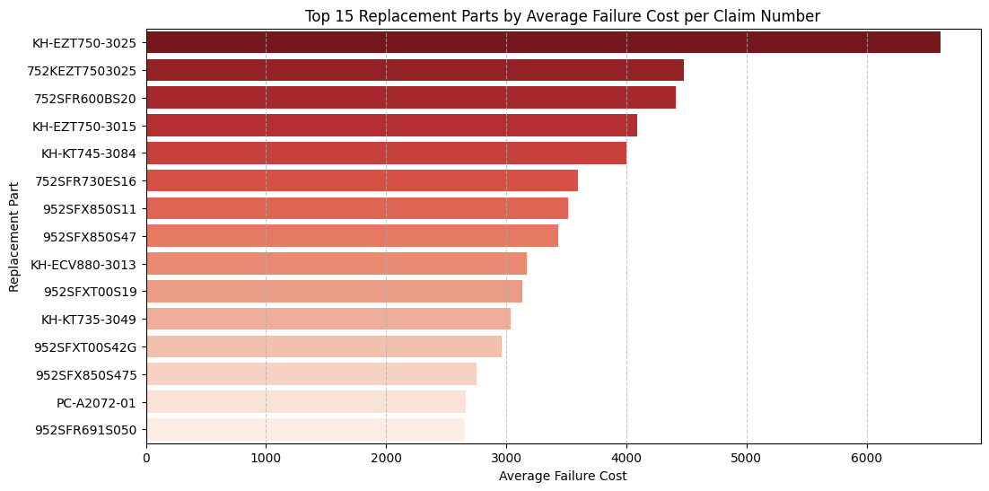
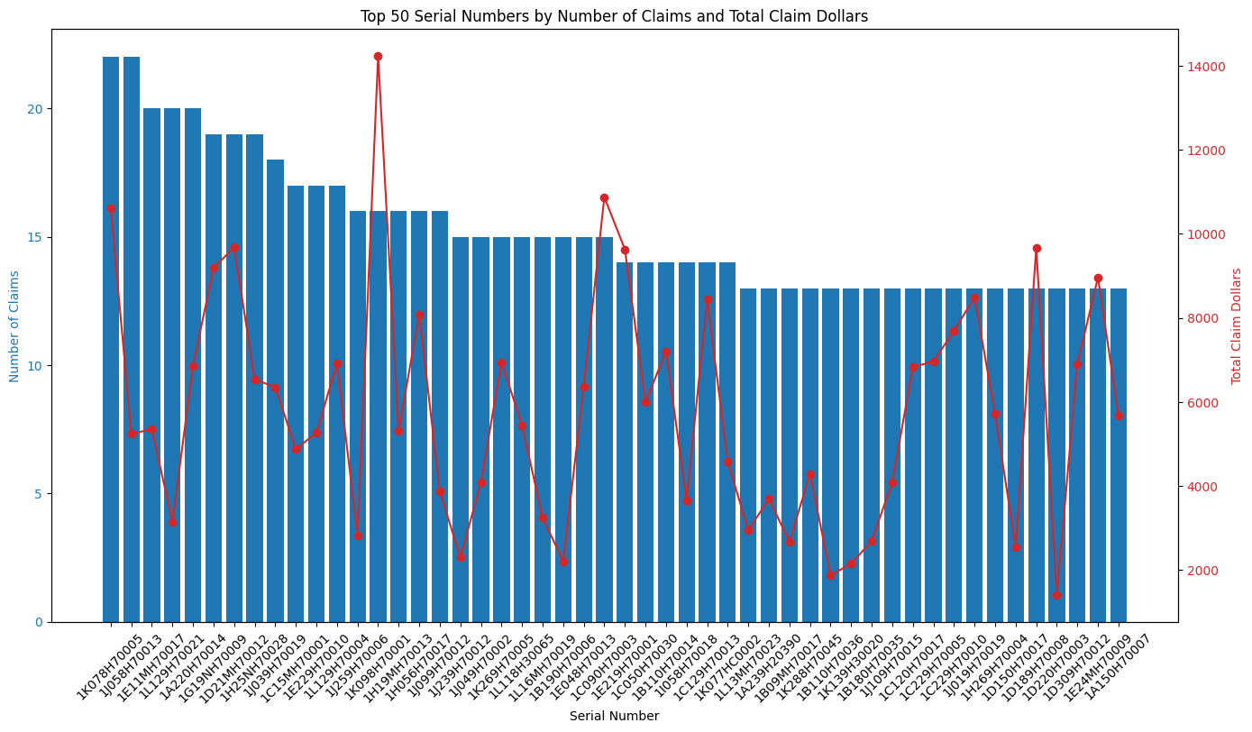
Top Replacement Part:
The KH-EZT750-3025 part has the highest average failure cost, exceeding $6,000 per claim.
Several EZT750 and FXT models appear in the top 15, suggesting certain part series are inherently expensive to replace.
The recurrence of KH, 752, and 952 series parts in this list suggests that certain vendors or manufacturers may need closer scrutiny.
Top Serial Numbers:
Top serial numbers have more than 20 claims each indicating recurring issues with specific machines
Consistent failure rate shows potential manufacturing or design defects.

